Slide 1

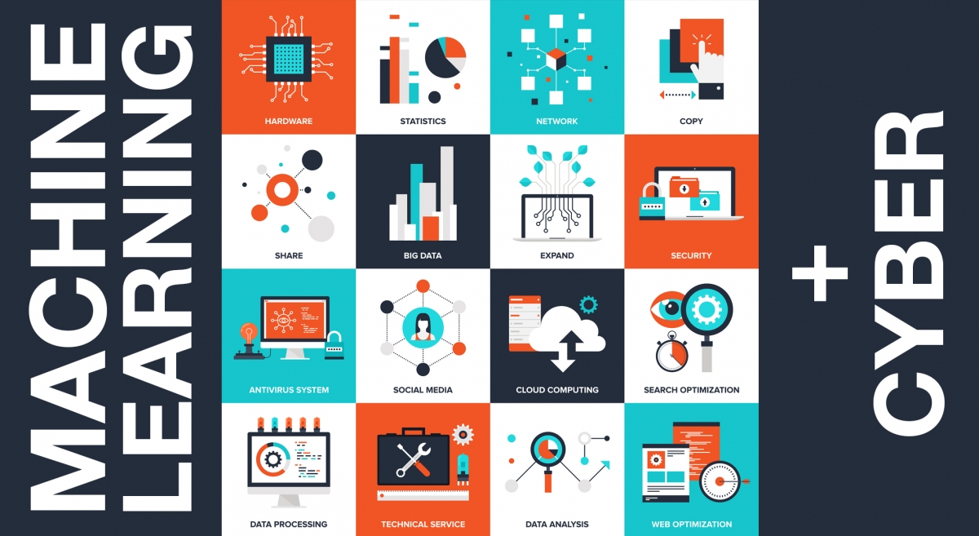
Artificial Intelligence for
Cybersecurity
Public Lectures
April 2019
o.sinelniko@samsung.com

Slide 2

Topic
Artificial Intelligence for
Cybersecurity
what is AI?
how can help AI in security?
how many security tasks?
Disclaimer:
This presentation is my personal opinion.
No statement must be attributed to Samsung.

Slide 3
Agenda
Terminology:
AI, ML, DL
General ML tasks
Different learning
Approaches to solving ML tasks
Cybersecurity tasks and ML
Malware Classification
Fraud detection
Network Protection
Endpoint protection
Application analysis based on ML
Adversarial attack

Slide 4

Agenda
Terminology: AI, ML, DL
General ML tasks
Different learning
Approaches to solving ML tasks
Cybersecurity tasks and ML
Malware Classification
Network Protection
Endpoint protection
Application analysis based on ML
Adversarial Attacks
Fraud detection

Slide 5
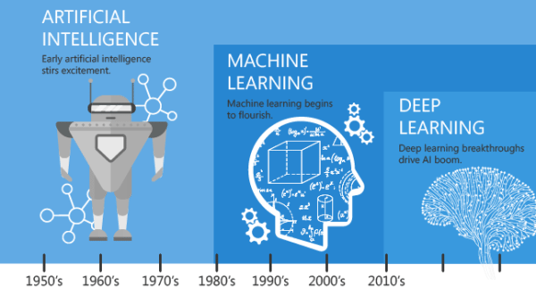
Terminology: AI, ML, DL

Slide 6
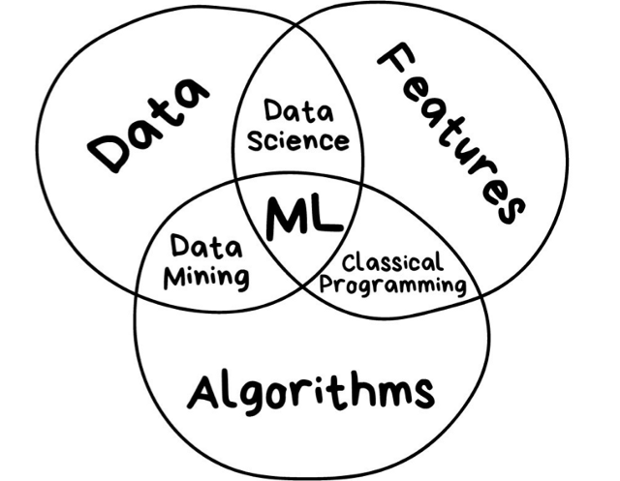
Terminology: AI, ML, DL
Stop calling everything ‘AI’
AI (Artificial Intelligence) — a broad concept. A Science of making things smart or, in other words, human tasks performed by machines.
ML (Machine Learning) — an Approach (just one of many approaches) to AI that uses a system that is capable of learning from experience. It can reduce the efforts and/or time spent for both simple and difficult tasks.
DL (Deep Learning) — a set of Techniques for implementing machine learning that recognize patterns of patterns.

Slide 7
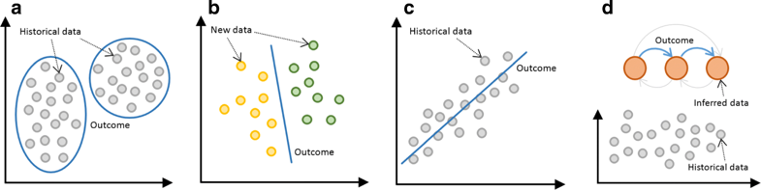
General ML tasks
Regression (or prediction) — predicting the next value based on the previous values
Classification — separating things into different categories
Clustering — similar to classification but the classes are unknown, grouping things by their similarity
Association rule learning (or recommendation) — recommending something based on the previous experience
Dimensionality reduction — searching common/most important features in multiple examples
Generative models — creating something based on the previous knowledge of the distribution
a Clustering. b Classification. c Regression. d Rule extraction
Notes:
https://jisajournal.springeropen.com/articles/10.1186/s13174-018-0087-2

Slide 8
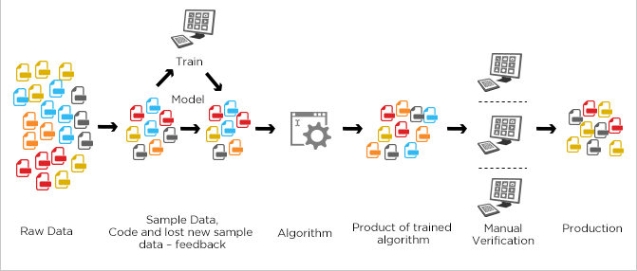
Different learning: Supervised learning
Trends of the past
Supervised learning
Ensembles learning
Supervised learning - you should label data like feeding a model with examples of executable files and saying that this file is malware or not. Based on this labelled data, the model can make decisions about the new data. The disadvantage is the limit of the labelled data.
Ensemble learning. This is an extension of supervised learning while mixing different simple models to solve the task.
Notes:
https://www.simplilearn.com/what-is-machine-learning-and-why-it-matters-article

Slide 9
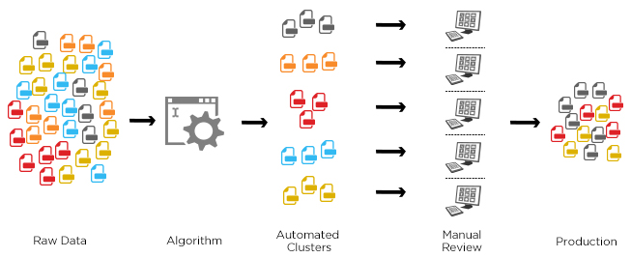
Different learning: Unsupervised Learning
Unsupervised Learning. Data Driven approach. The approach can be used when there are no labelled data and the model should somehow mark it by itself based on the properties.
Usually it is intended to find anomalies in data.
Currently it works less precisely than supervised approaches.
Notes:
https://www.simplilearn.com/what-is-machine-learning-and-why-it-matters-article

Slide 10
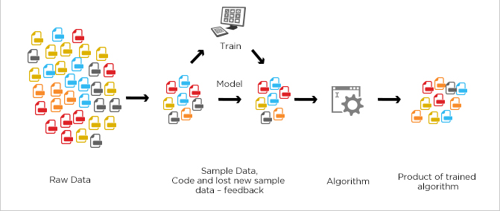
Different learning: Semi-supervised learning
Semi-supervised learning tries to combine benefits from both supervised and unsupervised approaches, when there are some labelled data
In a typical scenario, the algorithm would use a small amount of labeled data with a large amount of unlabeled data
Notes:
https://www.simplilearn.com/what-is-machine-learning-and-why-it-matters-article

Slide 11
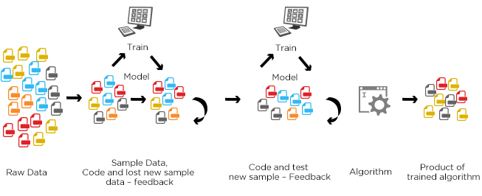
Different learning: Reinforcement learning
Reinforcement learning
Active learning
Future trends
Reinforcement learning. Environment Driven approach. It can be used when the behavior should somehow react on the changing environment. It’s like a kid who is learning environment by trial and error.
Active learning. It’s more like a subclass of Reinforcement learning that probably will grow into a separate class. Active learning resembles a teacher who can help correct errors and behavior in addition to environment changes.
Notes:
https://www.simplilearn.com/what-is-machine-learning-and-why-it-matters-article

Slide 12
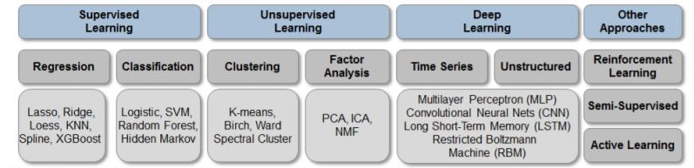
Approaches to solving ML tasks

Slide 13
Cybersecurity tasks
Why?
How?
The goal, or a task. According to Gartner’s PPDR model five categories:
prediction
prevention
detection
response
monitoring
What?
How to check security of a particular area:
in transit in real time
at rest
historically
etc.
The list of layers:
network (network traffic analysis and intrusion detection)
endpoint (anti-malware)
application (WAF or database firewalls)
user (UBA)
process (anti-fraud)
Notes:
For example, if you are about endpoint protection, looking for the intrusion, you can monitor processes of an executable file, do static binary analysis, analyze the history of actions in this endpoint, etc.

Slide 14
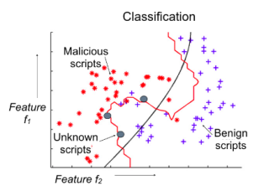
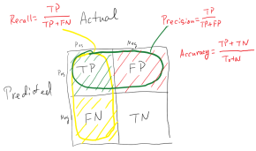



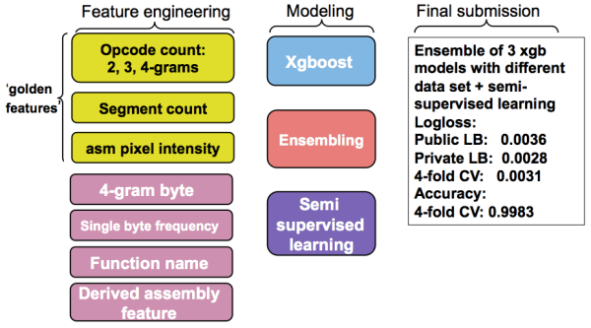
Malware Classification
ML VS Manual
Signature size reducing. Generation of high quality signature/model. Detection groups of similar malware
Labeled dataset:
different malware files
benign files
Dynamic and static analysis
Features extraction
Model training:
Classification
Clustering
Dimensionality reduction
Accuracy estimation
Instruction Sequence
Function Call Sequence
Control Flow Graph
Data Flow Graph
Network Communication
400 GB data
Microsoft Malware Classification Challenge (BIG 2015) Classify malware into families based on file content and characteristics
Notes:
https://www.slideshare.net/cisoplatform7/ai-approach-to-malware-similarity-analysis-maping-the-malware-genome-with-a-deep-neural-network

Slide 15

Network Protection
Ethernet, wireless, SCADA, virtual networks like SDNs
ML in network security implies new solutions called Network Traffic Analytics (NTA) aimed at in-depth analysis of all the traffic at each layer and detect attacks and anomalies.
There are some examples:
regression to predict the network packet parameters and compare them with the normal ones;
classification to identify different classes of network attacks such as scanning and spoofing;
clustering for forensic analysis.
Notes:
Machine Learning Techniques for Intrusion Detection
Long Short Term Memory Networks for Anomaly Detection in Time Series
Anomaly Detection Framework Using Rule Extraction for Efficient Intrusion Detection
A survey of network anomaly detection techniques
Shallow and Deep Networks Intrusion Detection System: A Taxonomy and Survey
Deep Packet: A Novel Approach For Encrypted Traffic Classification Using Deep Learning
Performance Comparison of Intrusion Detection Systems and Application of Machine Learning to Snort System
Evaluation of Machine Learning Algorithms for Intrusion Detection System
One Class collective Anomaly Detection based on LSTM
Network Traffic Anomaly Detection Using Recurrent Neural Networks
Sequence Aggregation Rules for Anomaly Detection in Computer Network Traffic
Big collection of all approaches for IDS

Slide 16
Endpoint protection
The new generation of anti-viruses is Endpoint Detection and Response.
Endpoint: workstation, server, container, cloud instance, mobile, PLC, IoT device, etc.
Intrusion detection and prevention, data leakage prevention, antimalware, spam detection systems
Approaches:
regression to predict the next system call for executable process and compare it with real ones;
classification to divide programs into such categories as malware, spyware and ransomware;
clustering for malware protection on secure email gateways (e.g., to separate legal file attachments from outliers).
Microsoft Malware Prediction
Can you predict if a machine will soon be hit with malware?
https://www.kaggle.com/c/microsoft-malware-prediction
Notes:
Malware Detection by Eating a Whole EXE
Deep learning at the shallow end: Malware classification for non-domain experts
TESSERACT: Eliminating Experimental Bias in Malware Classification across Space and Time

Slide 17
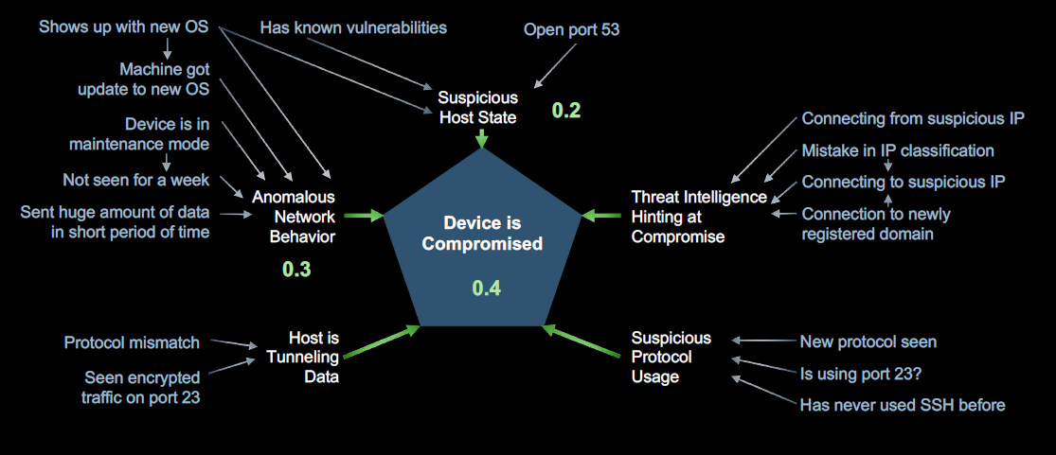
Endpoint protection
BAYESIAN BELIEF NETWORK
Complexity of this network is too high. We cannot computer all the conditional probabilities.
AI & ML in Cyber Security - Why Algorithms are Dangerous
https://www.blackhat.com/us-18/briefings/schedule/#ai--ml-in-cyber-security---why-algorithms-are-dangerous-10626
Notes:
Malware Detection by Eating a Whole EXE
Deep learning at the shallow end: Malware classification for non-domain experts
TESSERACT: Eliminating Experimental Bias in Malware Classification across Space and Time

Slide 18
Application analysis based on ML
Prevention
Protection
Application firewall, data leakage and anomalies detections:
regression to detect anomalies in HTTP requests (for example, XXE and SSRF attacks and auth bypass)
Testing: Fuzzers, vulnerabilities analysis, suspicious and malicious patterns detection:
classification to detect known types of attacks like injections (SQLi, XSS, RCE, etc.)
clustering user activity to detect DDOS attacks and mass exploitation
VulDeePecker: A Deep Learning-Based System for Vulnerability Detection
Fuzzing produces unexpected, erroneous and sometimes random inputs based on evolution algorithms, neural networks and fuzzy logic (Awesome Fuzzing)
Neural Classification of Malicious Scripts: A study with JavaScript and VBScript
Notes:
https://www.fortinet.com/blog/industry-trends/predictions--ai-fuzzing-and-machine-learning-poisoning-.html
https://arxiv.org/pdf/1801.01681.pdf
Adaptively Detecting Malicious Queries in Web Attacks
Neural Classification of Malicious Scripts: A study with JavaScript and VBScript
URLNet: Learning a URL Representation with Deep Learning for Malicious URL Detection

Slide 19
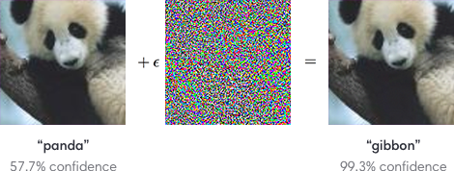
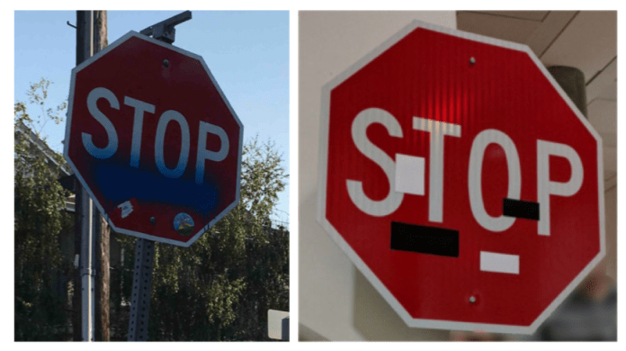
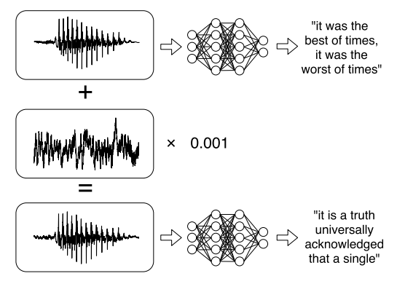
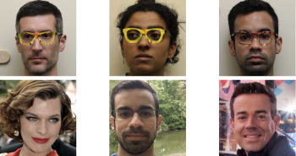
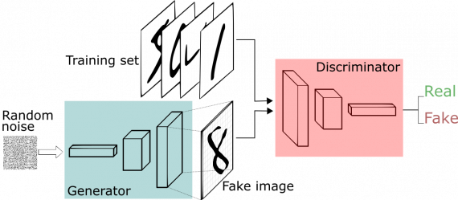
Adversarial Attacks
Fooling Computer Vision
Fooling Facial Recognition
Fooling Speech Recognition
Generative adversarial network, GAN
Notes:
https://www.analyticsindiamag.com/5-instances-where-neural-networks-deep-learning-came-under-attack/
Adversarial machine learning for av software: https://www.slideshare.net/junseokseo/adversarial-machine-learning-for-av-software
https://blog.trendmicro.com/trendlabs-security-intelligence/adversarial-sample-generation-making-machine-learning-systems-robust-for-security/
https://arxiv.org/pdf/1801.01944.pdf
https://neurohive.io/ru/novosti/airbnb-generation-stylegan/
https://arxiv.org/pdf/1805.06605.pdf
https://arxiv.org/pdf/1810.00069.pdf
https://arxiv.org/abs/1811.12026
https://arxiv.org/pdf/1801.00349.pdf
https://www.researchgate.net/publication/322328796_Attacking_Speaker_Recognition_With_Deep_Generative_Models
https://arxiv.org/abs/1801.02384?context=cs

Slide 20
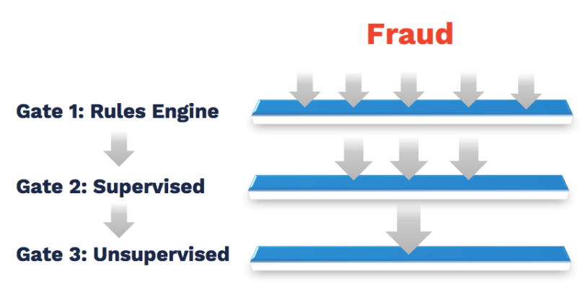

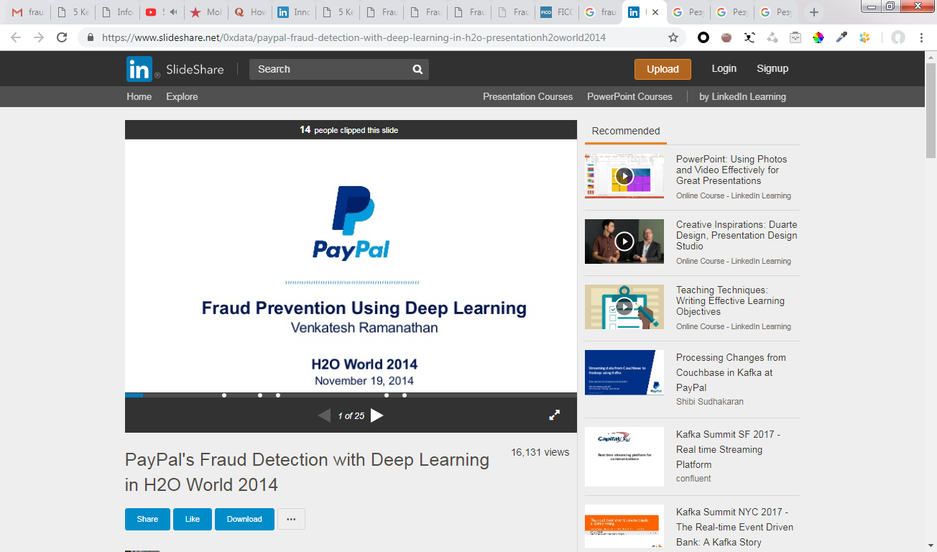

Fraud detection
Transaction profiles
Updated in real-time behavior ML profiles for each consumer’s activities
Collaborative profiles & Behavior sorted list
DL behavioral analytics that identify and rank recurrent activities that are unique to each individual
Merchant profiles
Aggregated transaction at merchant level. Detects behavior outliers in real-time
Global intelligent profiles
Real-time adaptive risk ranking
Notes:
Detecting Anomalous User Behavior Using an Extended Isolation Forest Algorithm: An Enterprise Case Study
Deep Learning for Unsupervised Insider Threat Detection in Structured Cybersecurity Data Streams
Fraud with autoencoders
A Survey of Credit Card Fraud Detection Techniques: Data and Technique Oriented Perspective
Anomaly detection; Industrial control systems; convolutional neural networks
Innovation Around Data and AI for Fraud Detection https://www.slideshare.net/DataStax/innovation-around-data-and-ai-for-fraud-detection
Adaptive Machine Learning for Credit Card Fraud Detection http://di.ulb.ac.be/map/adalpozz/pdf/Dalpozzolo2015PhD.pdf

Slide 21
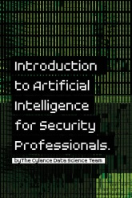


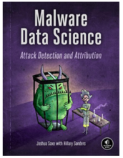
Machine Learning Cybersecurity Books
AI for Cybersecurity by Cylance (2017)
Machine Learning and Security by O’reilly (January 2018 )
Machine Learning For Penetration Testers, by Packt (July 2018 )
Malware Data Science: Attack Detection and Attribution (sept 2018)

Slide 22
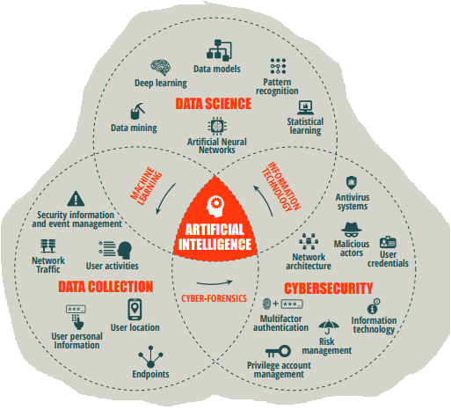
Conclusion
What can Machine Learning do for Cybersecurity?
User entity behavior analytics, DL, automation
Assist IT professionals and defend against new cyber threats
Better predictive models, lower FPR, distill new metrics
Fraud and anomaly detection
Better use of internal data and global repositories
Tackle device influx and enhanced data loss prevention (DLP solution)

Slide 23
How to Join
R&D Institute Ukraine
Send us E-Mail: «я хочу спробувати»
srk.hr@samsung.com
+38 050 411 9960

